Slide 1
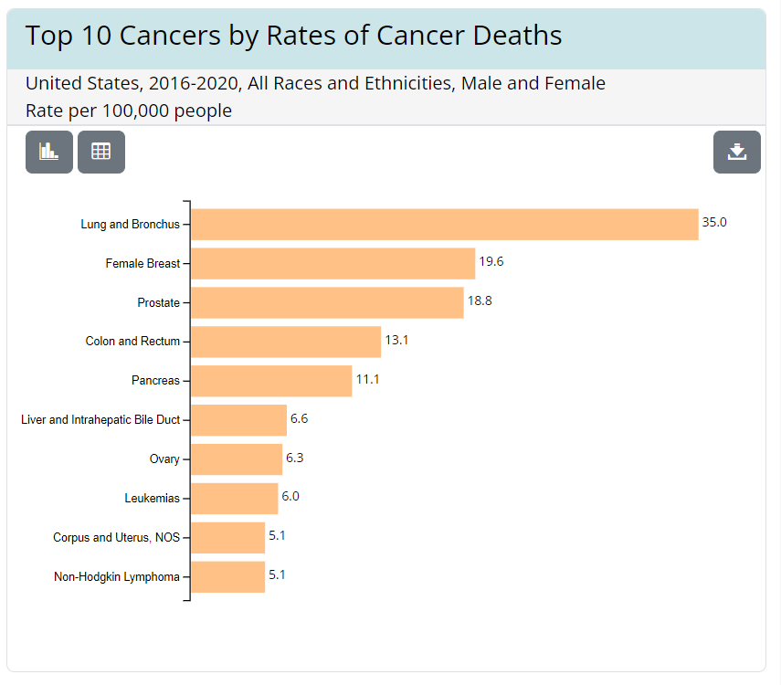
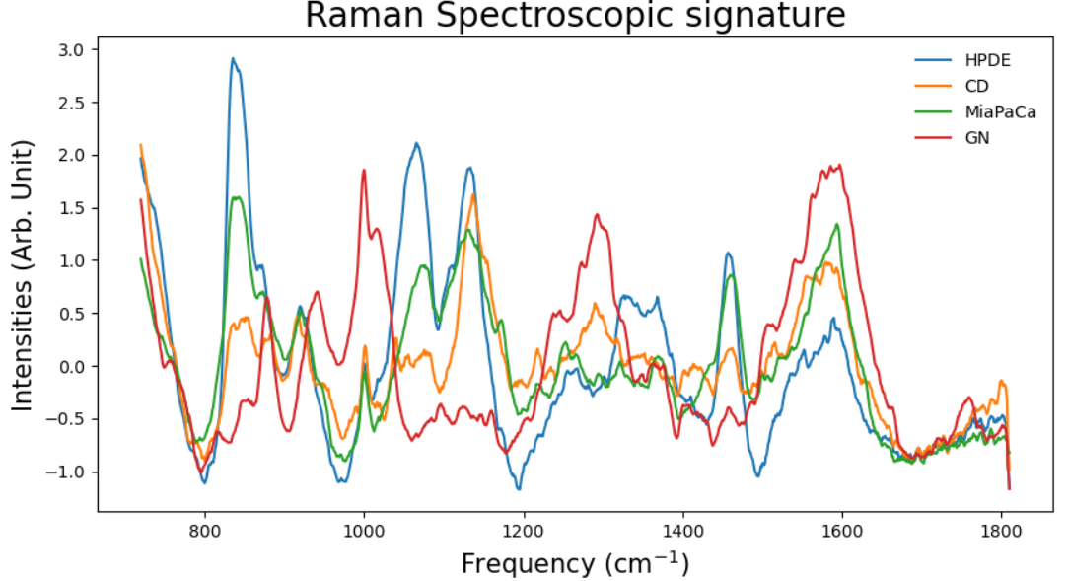
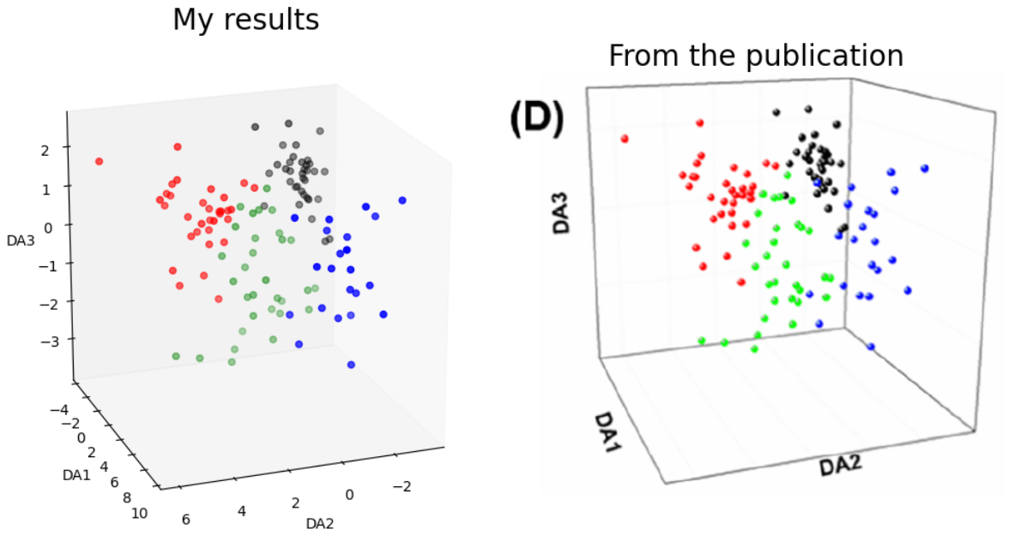
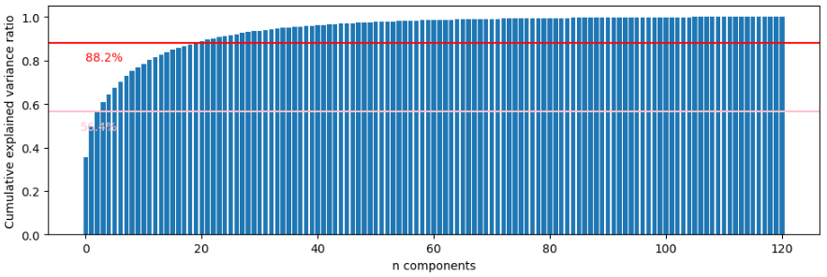
Detection of pancreatic cancer through Raman Spectroscopy and machine learning
Kiman B. Park
Outline:
War on cancer
MLops
Results
conclusion

Slide 2
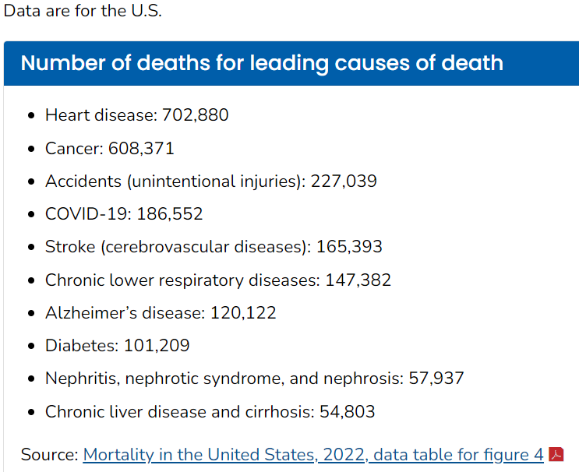
War on cancer
Cancer is #2 leading disease in the country
https://gis.cdc.gov/Cancer/USCS/#/AtAGlance/
https://www.cdc.gov/nchs/fastats/leading-causes-of-death.htm
Pancreatic cancer has the #5 highest mortality rate among all cancers

Slide 3
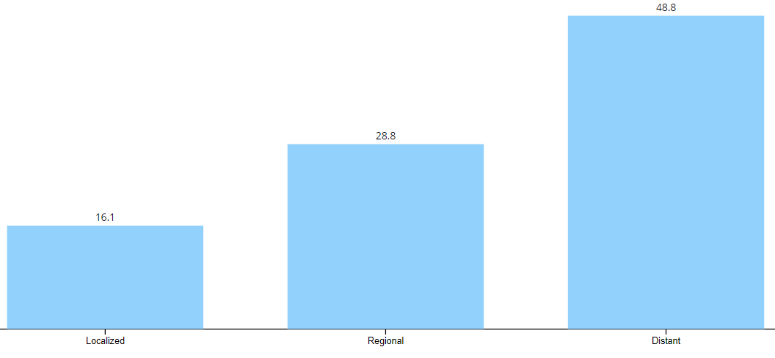
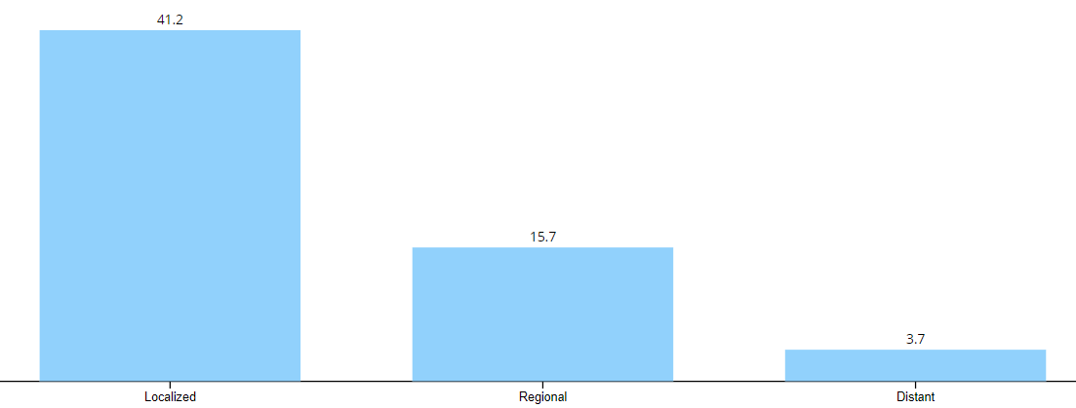
War on cancer
Mostly diagnosed at Distant stage, which has spread throughout the body
Survival rates are the highest when the disease is caught early and localized
https://gis.cdc.gov/Cancer/USCS/#/AtAGlance/

Slide 4
War on cancer
There are diagnostic techniques that verify pancreatic cancer.
Imaging tests
Endoscopic ultrasound (EUS)
Computed Tomography (CT) scan
Magnetic Resonance Imaging (MRI) scan
Positron Emission Tomography (PET) scan
Biopsies
During EUS, samples are obtained through a special tool
Fine-needle aspiration can be used as well, which is done by inserting a needle through a skin to collect a sample
Blood tests
Genetic tests
Expensive
Expensive
Cheap
Expensive
https://www.mayoclinic.org/diseases-conditions/pancreatic-cancer/diagnosis-treatment/drc-20355427#:~:text=Imaging%20tests%20used%20to%20diagnose,and%20nearby%20organs%20and%20tissues.

Slide 5
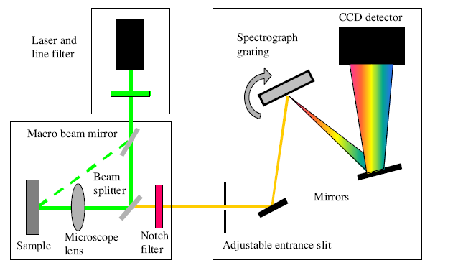
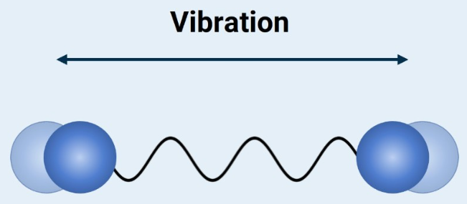
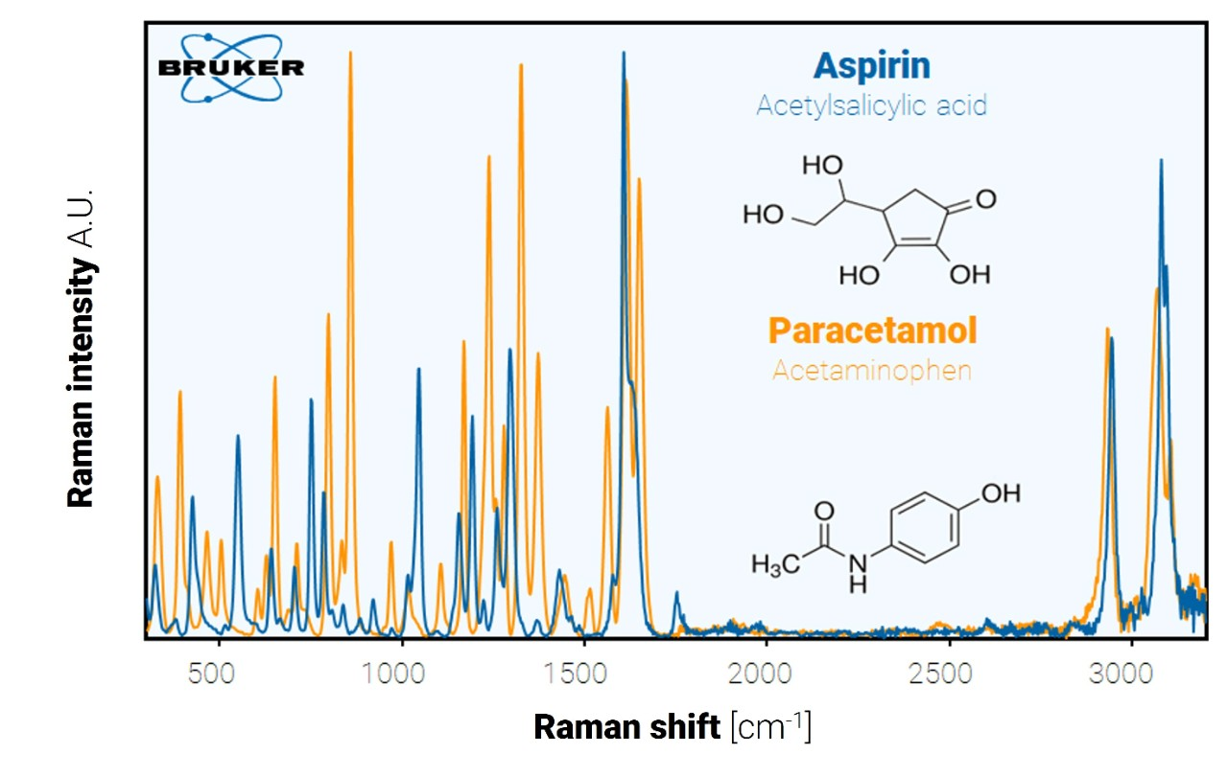
War on cancer
https://www.sas.upenn.edu/~crulli/TheRamanSpectrophotometer.html
In the blood test, serum-based cancer markers are a promising area, where exosomes are targeted to detect pancreatic cancer
Raman Spectroscopy offers a non-invasive, non-destructive, and cheap technique to pursue.
It measures the vibrational properties of materials that can be used as a fingerprint.
Furthermore, Surface-Enhanced Raman Spectroscopy (SERS) provides better scattering efficiencies, which will amplify the signal and detect extremely small amounts of materials.
https://www.bruker.com/en/products-and-solutions/infrared-and-raman/raman-spectrometers/what-is-raman-spectroscopy.html

Slide 6
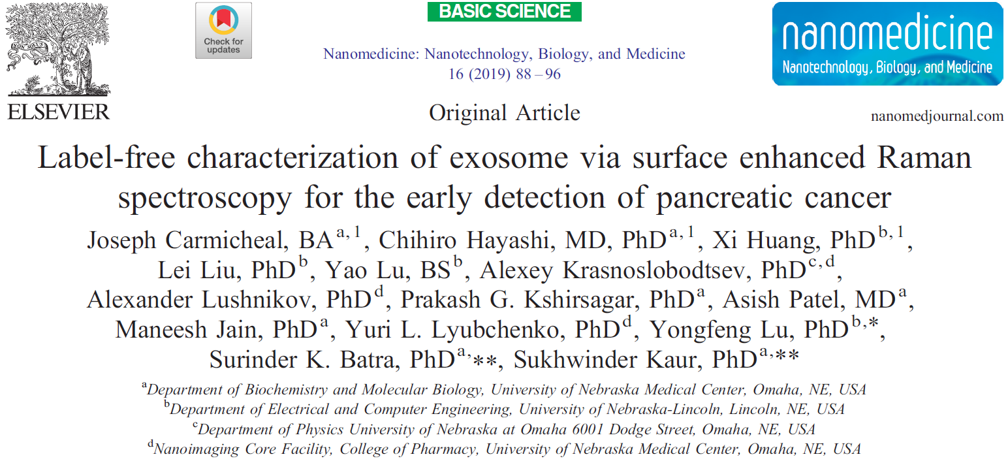
War on cancer
We will utilize machine learning methods to further the advancement of cancer detection methods!!!
We look at this article to bench mark our results

Slide 7
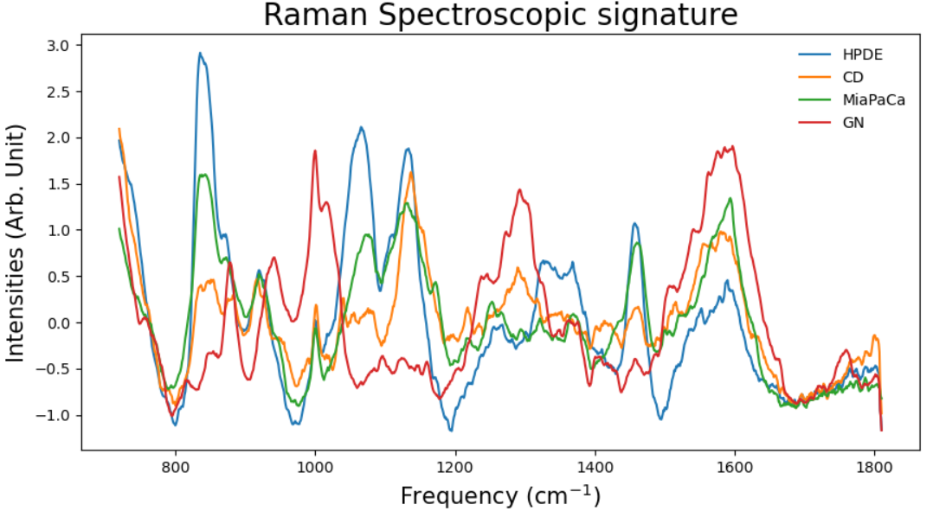
War on cancer
There are three exosomes of interest
CD18/HPAF – we will simply call this CD
HPDE
MiaPaCa
The control
GN – This represents Gold Nanoparticle (for SERS method)
Cancer
Healthy
We obtained the data through https://data.mendeley.com/datasets/f5hfzmy78z/1

Slide 8
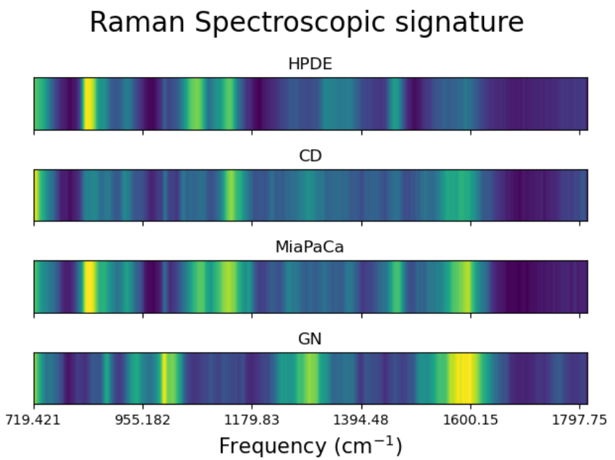
War on cancer
As you can see, Raman spectra provide a fingerprint of markers.

